Slide 1

Matthew’s Journey: Godot Game Development
From Team NoGrads

Slide 2
Team NoGrads // Godot Game Project
Robert Dallessandris
BS Computer Science Senior
Team Role: Gameplay and Mechanics Developer
Virginia Richards
BS Computer Science Senior & Math minor
Team Role: Systems and Gameplay UI Developer
Josiah Yount
BS Computer Science Senior, Cybersecurity Certificate
Team Role: Narrative and Music Developer
Cara Zozokos
BA Computer Science, Cybersecurity Certificate
Team Role: Level and Menu UI Developer

Slide 3
Our Pitch
Godot programmed videogame named Matthew's Journey
2D top down, Zelda-like adventure game
With real-time hack and slash combat
2D pixel art, sound, & music will be outsourced
None of the team has made a game of this scope before
Notes:
Revise!!!!

Slide 4
Overview
Outline of presentation
Architecture overview figure
Notes:
Revise!!!!

Slide 5
Piece of Complexity (Dupe this)
pieces of complexity from SDP
for each piece:
intro at least one user store
one requirement
one design
implementation gif or figure
brief conclusion
each person should contribute to the presentation
Notes:
Revise!!!!

Slide 6
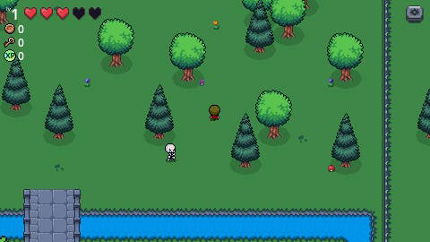
Combat
pieces of complexity from SDP
for each piece:
intro at least one user store
one requirement
one design
implementation gif or figure
brief conclusion
each person should contribute to the presentation
Notes:
Revise!!!!

Slide 7
Conclusion
conclusion slide for how we thought the class as a whole (not group) went
Notes:
Revise!!!!

Slide 8
Questions?
Notes:
After 11 minutes

